Slide 1
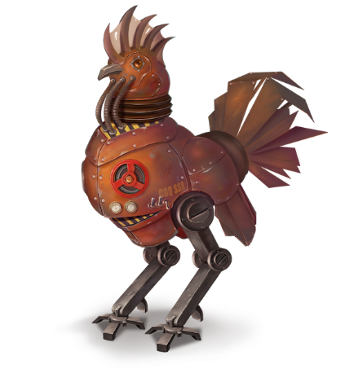
Proofs are Programs Summer 2023 @ Ruhr Uni Bochum
Lecturers: Cătălin Hrițcu and Clara Schneidewind
TAs: Sebastian Holler and Maxi Wuttke
Max Planck Institute for Security and Privacy (MPI-SP)

Slide 2
This course in a nutshell
1. Logic and proofs
2. Functional programming
3. Program verification
Using the Coq proof assistant
Curry-Howard correspondence
proofs = programs
bridge between logic and computer science
["Le coq mécanisé" picture by Lilia Anisimova]

Slide 3
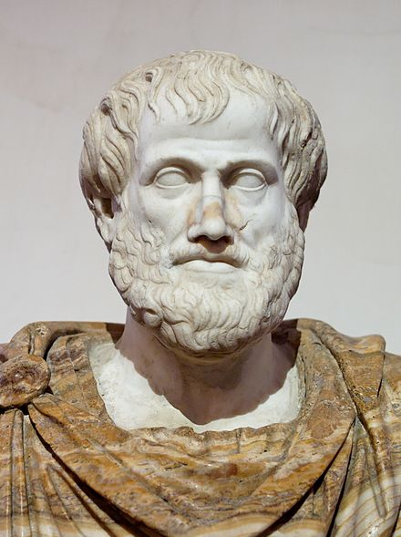
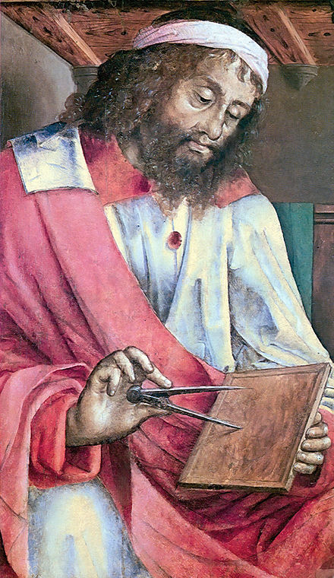
Logics and proofs
Q: How do we know something is true?
A: We prove it
Q: How do we know that we have a proof?
A: We need to know what it means for something to be a proof. First cut: A proof is a “logical” sequence of arguments, starting from some initial assumptions
Q: How do we agree on what is a valid sequence of arguments? Can any sequence be a proof? E.g.
All humans are mortal
All Greeks are human
Therefore I am a Greek!
A: No, no, no! We need to think harder about valid ways of reasoning...
Aristotle
384 – 322 BC
Euclid
~300 BC

Slide 4

The story of logics is quite fascinating
David Hilbert (1862 – 1943)
Gottlob Frege (1848-1925)
first-order logic (∀x. P x /\ R x x)
derive the laws of arithmetic from first principles (Problem #2)
Bertrand Russell (1872 - 1970)
paradox, inconsistency in Frege's logical system, tried to fix it
Principia Mathematica
Kurt Gödel (1906 - 1978)
incompleteness theorems
Gerhard Gentzen (1909-1945) -- consistency of arithmetic
Alonzo Church (1903 - 1995) -- lambda calculus, simple theory of types
Alan Turing (1912 - 1954) -- undecidability of arithmetic, halting problem
Notes:
TODO: expand this based

Slide 5
Logics and proofs
Foundation of mathematics and computer science
formal proofs with respect to valid inference steps/rules
This course: typed constructive higher-order logic
higher-order
can quantify not only over individuals (∀x:nat. P x)
but also over propositions (∀P:Prop. P), predicates (∀Q:nat->Prop. Q x), relations (∀R:nat->nat->Prop. R x y), functions (∀f:nat->bool, ∀g:(nat->bool)->bool), ...
constructive, aka intuitionistic logic:
a proposition is valid if one can construct a proof
philosophically rejects excluded middle (P ∨ ¬P, classical logic)
typed (dependently typed)

Slide 6
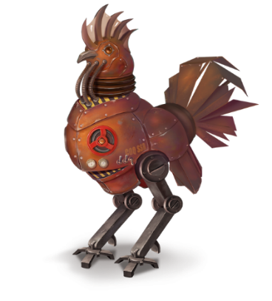
Logic and computer science
Logic and CS greatly influenced on each other, e.g.:
automated theorem provers (e.g., SAT and SMT solvers)
model checkers (the course right after this one!)
proof assistants: Coq, Isabelle, HOL family, F*, ACL2, etc.
interactively constructed, machine-checked proofs
addictive, gamification of proofs
This course: Coq proof assistant
developed at Inria since 1983 (in OCaml)
Curry-Howard: proofs = typed purely functional programs

Slide 7
Functional programming
Try to write computations as pure functions
without side-effects, such as mutating the heap
sorting a list in place (imperative) vs producing a new list (functional)
Coq is purely functional = zero side-effects
all computations are mathematical functions (in particular terminating)
Functional programming languages like OCaml, Haskell, ...
try to reduce and/or control side-effects
make it easy to write pure functions
Notes:
TODO: insert lambda logo

Slide 8
Functional programming in practice
Functional languages have some practical success
Facebook (OCaml, Haskell), Microsoft (F# and F*), Twitter (Scala)
Financial industry: Jane Street (OCaml), various banks (Haskell, ...)
Blockchains: Cardano (Haskell, Rust), Tezos (OCaml), ...
Not yet fully mainstream, but ...
Functional programmers earn more (Stack Overflow survey)
Many ideas already adopted by mainstream languages: lambdas, generics in Java/C#, Google's Map-Reduce, ...
Makes program verification and informal reasoning easier

Slide 9
Program verification in proof assistants Proving mathematically that a program satisfies a specification
verification of smart contracts (Coq, F*, ...) -- Clara working on this hot topic
the CompCert C compiler (Coq) -- Catalin working on a more secure version
the seL4 OS microkernel (Isabelle/HOL), the CertiKOS hypervisor (Coq)
EverCrypt cryptographic library (F*) -- shipping in Firefox and the Linux kernel
EverParse3D verified binary parsers (F*) -- shipping in Windows kernel
Catalin working on design of F* proof assistant ("Coq + SMT automation")
Libjade high-assurance post-quantum crypto library (EasyCrypt)
Peter Schwabe and Gilles Barthe from MPI-SP

Slide 10
Machine-checked proofs of math theorems
The 4-color theorem
proved in 1976, simplified in 1996
proofs rely on a computer
infeasible for a human to check
initially not accepted by all mathematicians
mechanized in Coq by Georges Gonthier in 2005
Odd order theorem (Feit-Thompson)
Coq proof from 2012 introduced the Mathematical Components library
Construction of perfectoid spaces (Peter Scholze, Lean)
Mathlib math library for Lean has over 100,000 theorems, over 1,000,000 lines of code, and an active community including many mathematicians
[World map from Wikipedia]
Notes:
4 color: no more than four colors are required to color the regions of any map so that no two adjacent regions have the same color
Feit-Thompson:
first major step in the classification of finite simple groups
states that every finite group of odd order is solvable
Saved slide space:
Hales' proof of Kepler conjecture (HOL Light and Isabelle)

Slide 11

This course
Write purely functional programs in Coq
natural numbers, lists, maps, trees, program syntax
Verify these programs by proving theorems about them
case analysis, induction, inversion, proof automation, ...
Curry-Howard correspondence
proofs = typed purely functional programs
Advice: focus, ask questions, interact

Slide 12
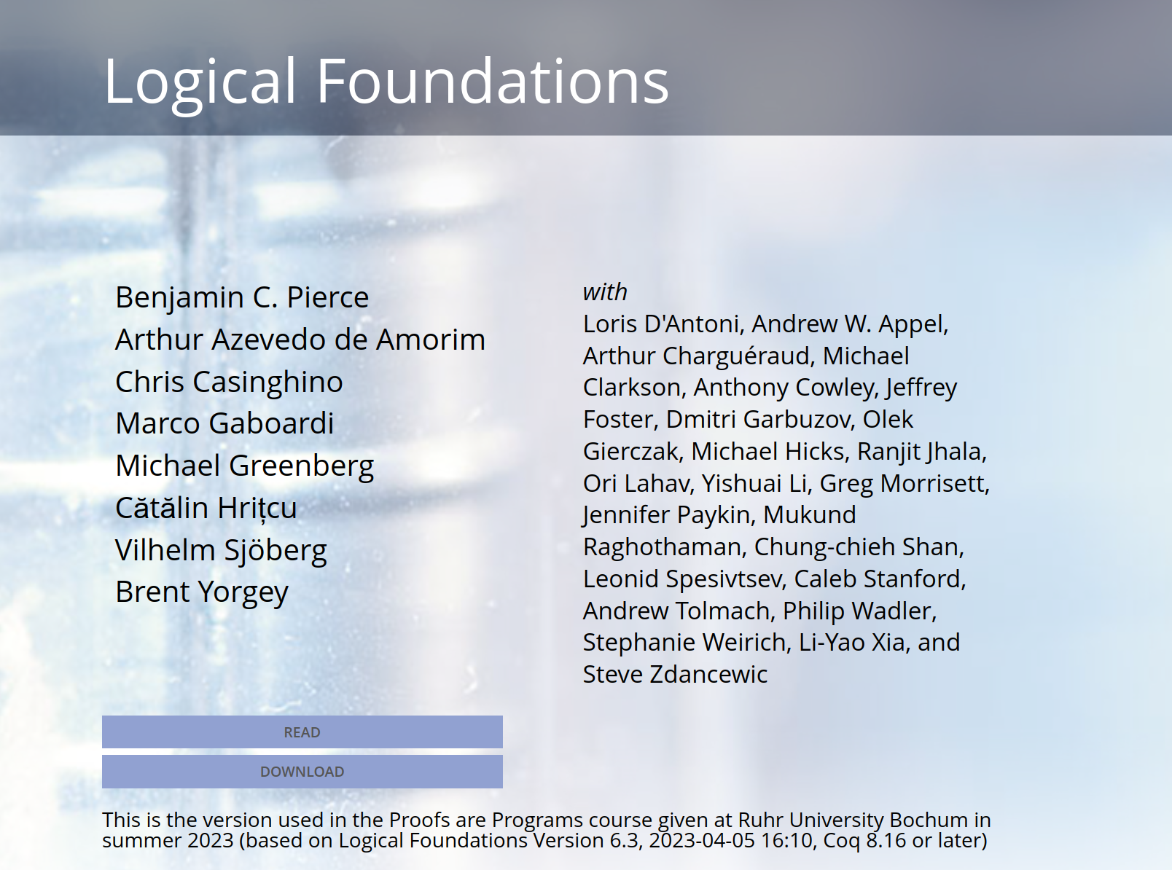
Textbook written in Coq; our version at: https://mpi-sp-pap-2023.github.io/book

Slide 13
Lecture logistics
12 lectures: first 6 by Clara, last 6 by Catalin
Public holidays, so no lecture on 18 May and 8 June
Vacation 29 May to 2 June, so no lecture, no tutorials
Starting next week only in presence

Slide 14
Exercises
This is a very hands on course
Coq turns proofs & logic into programming, and it's fun!
New exercise sheet will be released after most courses
1(-2) Coq file(s) with holes you have to fill (basically 1-2 book chapters)
so there will be 8-10 exercise sheets in total
You have to turn in your solution before next course
up to Wednesday at 23:59
Easter exception: this week's exercise sheet is due in 2 weeks
We'll be using Moodle (probably for everything)
Exercises count for 40% of final grade (+5% in bonus points)
not required to do the optional exercises; they don't count for grade
Exercises highly recommended even if you're not taking this for credit

Slide 15
Tutorials: Q&A about the exercise sheets
TAs: Sebastian Holler and Maxi Wuttke
Monday 12:00-14:00 and Tuesday 12:00-14:00
You can come to any/both and ask questions
Can also work on your own during tutorials
and ask questions as they arise
If you manage to solve all the exercises and prefer to not come, no problem, you are not forced to come
can sometimes still get good advice though
can also ask about old assignments (but solutions anyway on Moodle)
Seems okay to bring your lunch / arrive late / leave early

Slide 16
Exams
Midterm exam (optional)
practice for the final exam
also written, on paper
duration: 60 minutes
bonus points: up to 10%
date: 23 May, 13:00-14:00
Final exam
written, on paper
so we will also teach you how to write down proofs informally
duration: 120 minutes
60% of the grade
date: 3 August
re-exam: 19 September

Slide 17
Final grade
CASA PhD students
attendance requirement is to receive 50% of the exercises score
You can get credit if you study
Computer Science BSc (soon MSc too)
IT Security BSc and MSc
Mathematics MSc
Exercises (5% bonus)
Exercises (40%)
Final exam (60%)
Midterm (10% bonus)
You need 50% of this to pass and get credit
You need close to 100% of this to get 1.0

Slide 18
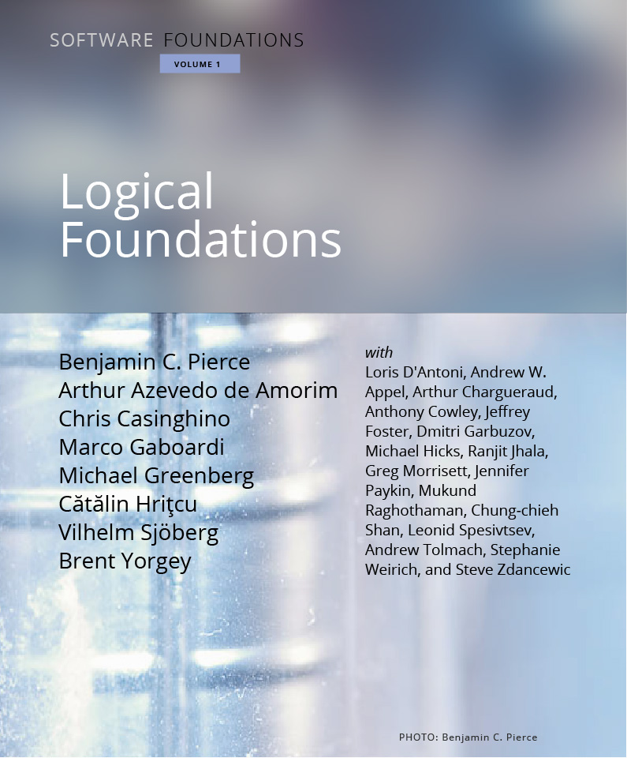
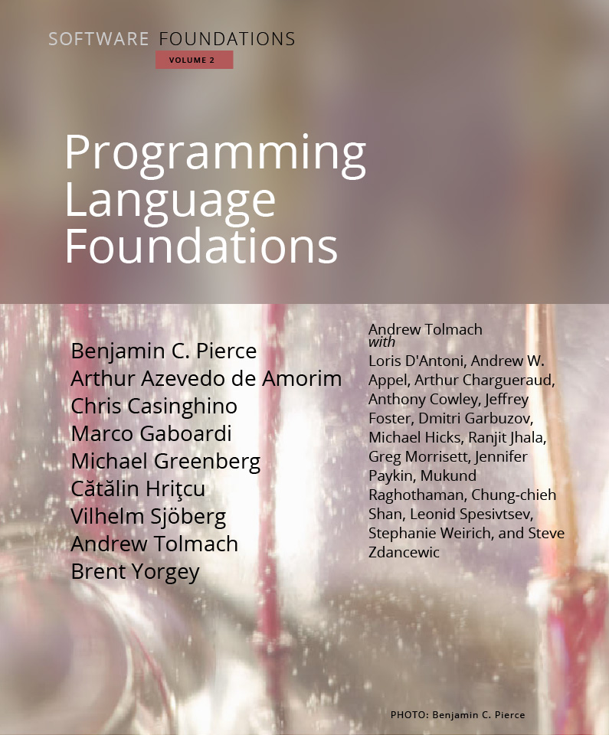
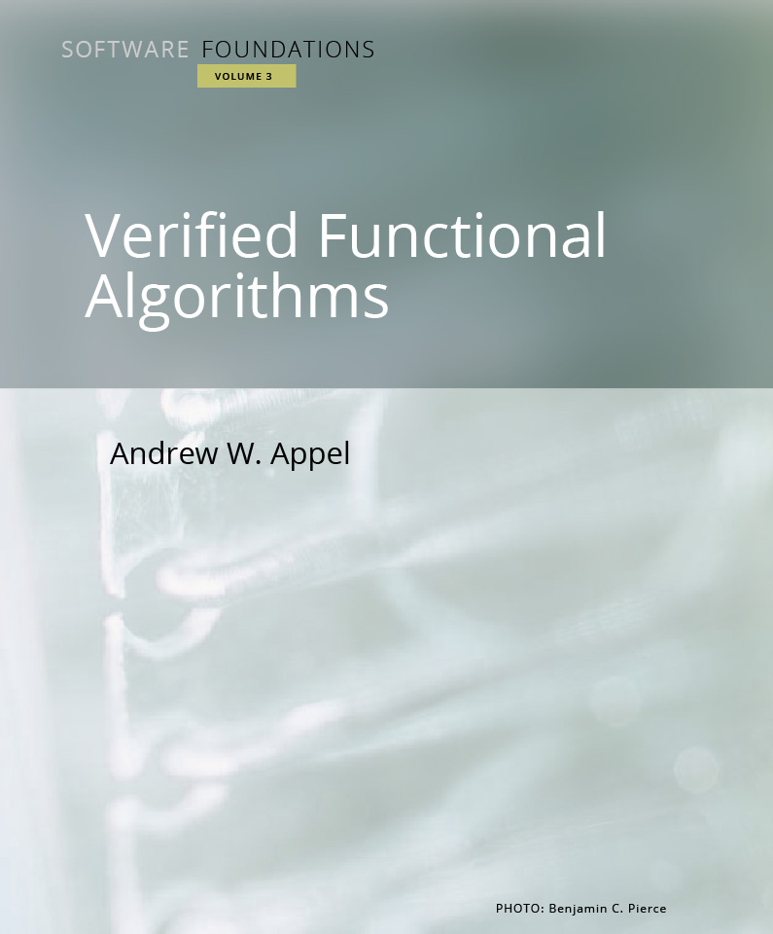
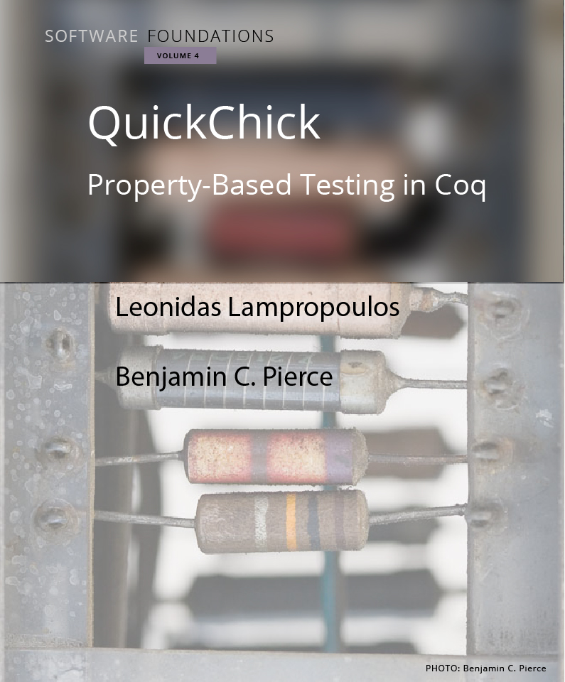
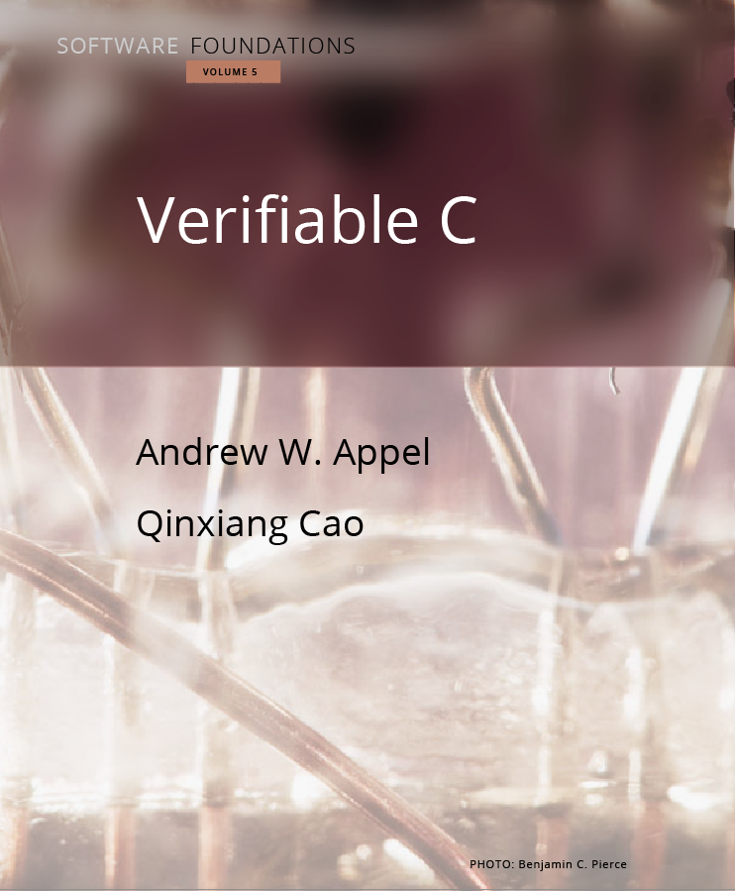
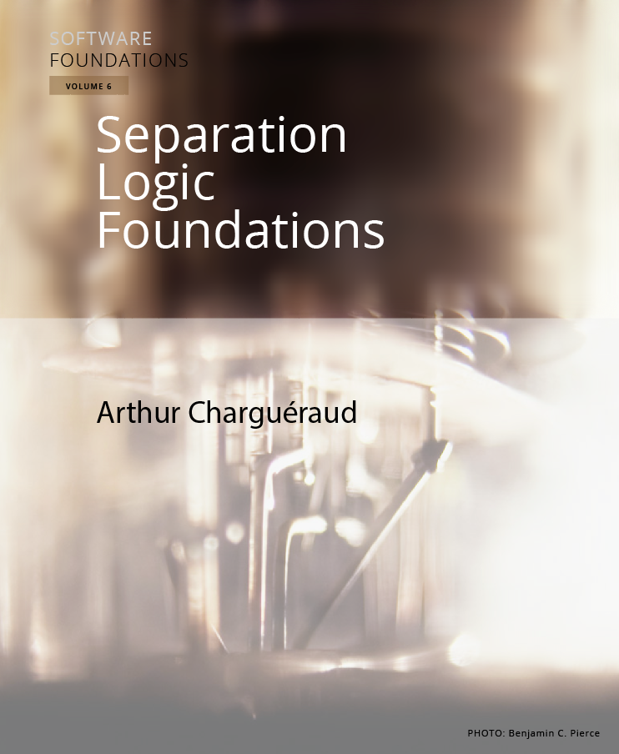
Already considering follow up course (next semester?) Foundations of Programming Languages, Verification, and Security

